Slide 1
The space program
Moon landing goal
competing with the Soviets in the Cold War
asked Congress to fund the unmanned exploration of space
Source: Ayers, E. L., Schulzinger, R. D., de la Teja J.F. & Gray White, D. (2009). American anthem: Modern American history. Orlando: Holt, Rinehart and Winston. .Educational purposes only.

Slide 2
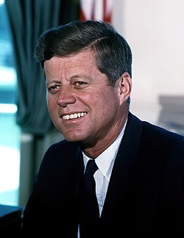
John F. Kennedy
https://commons.wikimedia.org/wiki/File:John_F._Kennedy,_White_House_color_photo_portrait.jpg

Slide 3
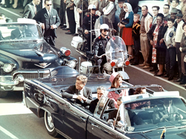
Kennedy’s Assassination
November 22, 1963
https://commons.wikimedia.org/wiki/File:JFK_limousine.png

Slide 4
The Civil Rights Movement (1954-1975)

Slide 5
The Civil Rights Movement Before 1954
Booker T. Washington and W.E.B. Du Bois
National Association for the Advancement of Colored People, or NAACP (1909)
1940s – President Truman

Slide 6
End of Legal Segregation
"separate but equal"
Brown v. Board of Education of Topeka, Kansas
Chief Justice Earl Warren
separate schools

Slide 7
The Little Rock crisis
schools that were segregated by law in 21 states
Little Rock, Arkansas
Governor Orval Faubus
On September 4, 1957, a crowd of angry white students harassed the black students on the first day of school

Slide 8
The Montgomery bus boycott
bus system in Montgomery, Alabama
1955 – Rosa Parks, a local NAACP member
first, a one-day boycott of the city bus system; later it continued
Martin Luther King, Jr.
1956 – Supreme Court said the segregation on buses was unconstitutional.

Slide 9
Birth of the SCLC
Southern Christian Leadership Conference, or SCLC
Martin Luther King Jr. is the leader

Slide 10
Sit-ins and Freedom Rides
based on Mahatma Gandhi’s ideas
nonviolent resistance
arrests and harassment

Slide 11
The Freedom Rides
The Court's order about desegregation was not being enforced
Freedom Riders
May, 1961, a group of 13 volunteers – the bus was attacked
The protest ended in September 1961

Slide 12
Higher Education
University of Georgia
University of Mississippi – James Meredith wanted to enroll
  - hundreds of people had been injured and two killed
University of Alabama - Governor George Wallace physically prevented two students from enrolling.

