Slide 1
Women’s Movement
Source: Ayers, E. L., Schulzinger, R. D., de la Teja J.F. & Gray White, D. (2009). American anthem: Modern American history. Orlando: Holt, Rinehart and Winston

Slide 2
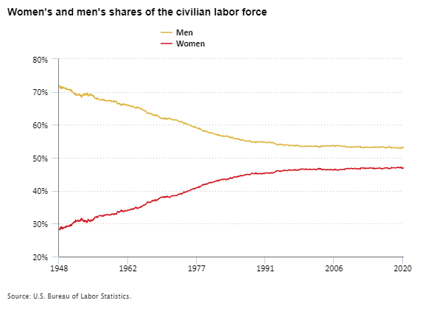
https://www.bls.gov/blog/2021/celebrating-women-s-history-month-with-a-look-at-women-in-the-labor-force.htm

Slide 3
1961 – The Presidential Commission on the Status of Women (JFK)

Slide 4
Betty Friedan – The Feminine Mystique (1963)
The Women’s Liberation Movement in 1960s and 1970s
(the feminist movement, the equal rights movement)
1966 – National Organization for Movement (NOW)

Slide 5
«We believe that women will do most to create a new image of women by acting now, and by speaking out in behalf of their own equality, freedom, and human dignity ... in an active, self-respecting partnership with men. By so doing, women will develop confidence in their own ability to determine actively, in partnership with men, the conditions of their life, their choices, their future and their society.»
-NOW's Statement of Purpose, 1966

Slide 6
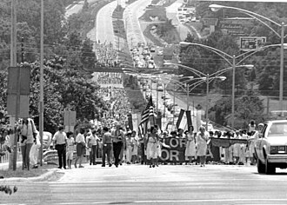
Equal Rights Amendment (ERA)
https://commons.wikimedia.org/wiki/File:Pro-ERA_forces_march_dnd0211.jpg

Slide 7
Roe v. Wade
abortion

Slide 8
Rising Student Activism
Students rose against school policies they considered unjust
protests at University of California at Berkeley
- marked the beginning of the Free Speech Movement, spread across campuses

Slide 9
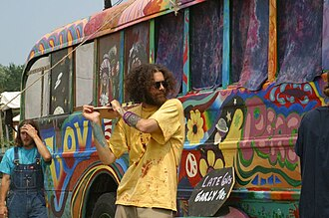
Counterculture
https://commons.wikimedia.org/wiki/File:Hippies.jpg

Slide 10
Rising student activism
University of California at Berkeley
John Weinberg
Free Speech Movement

Slide 11
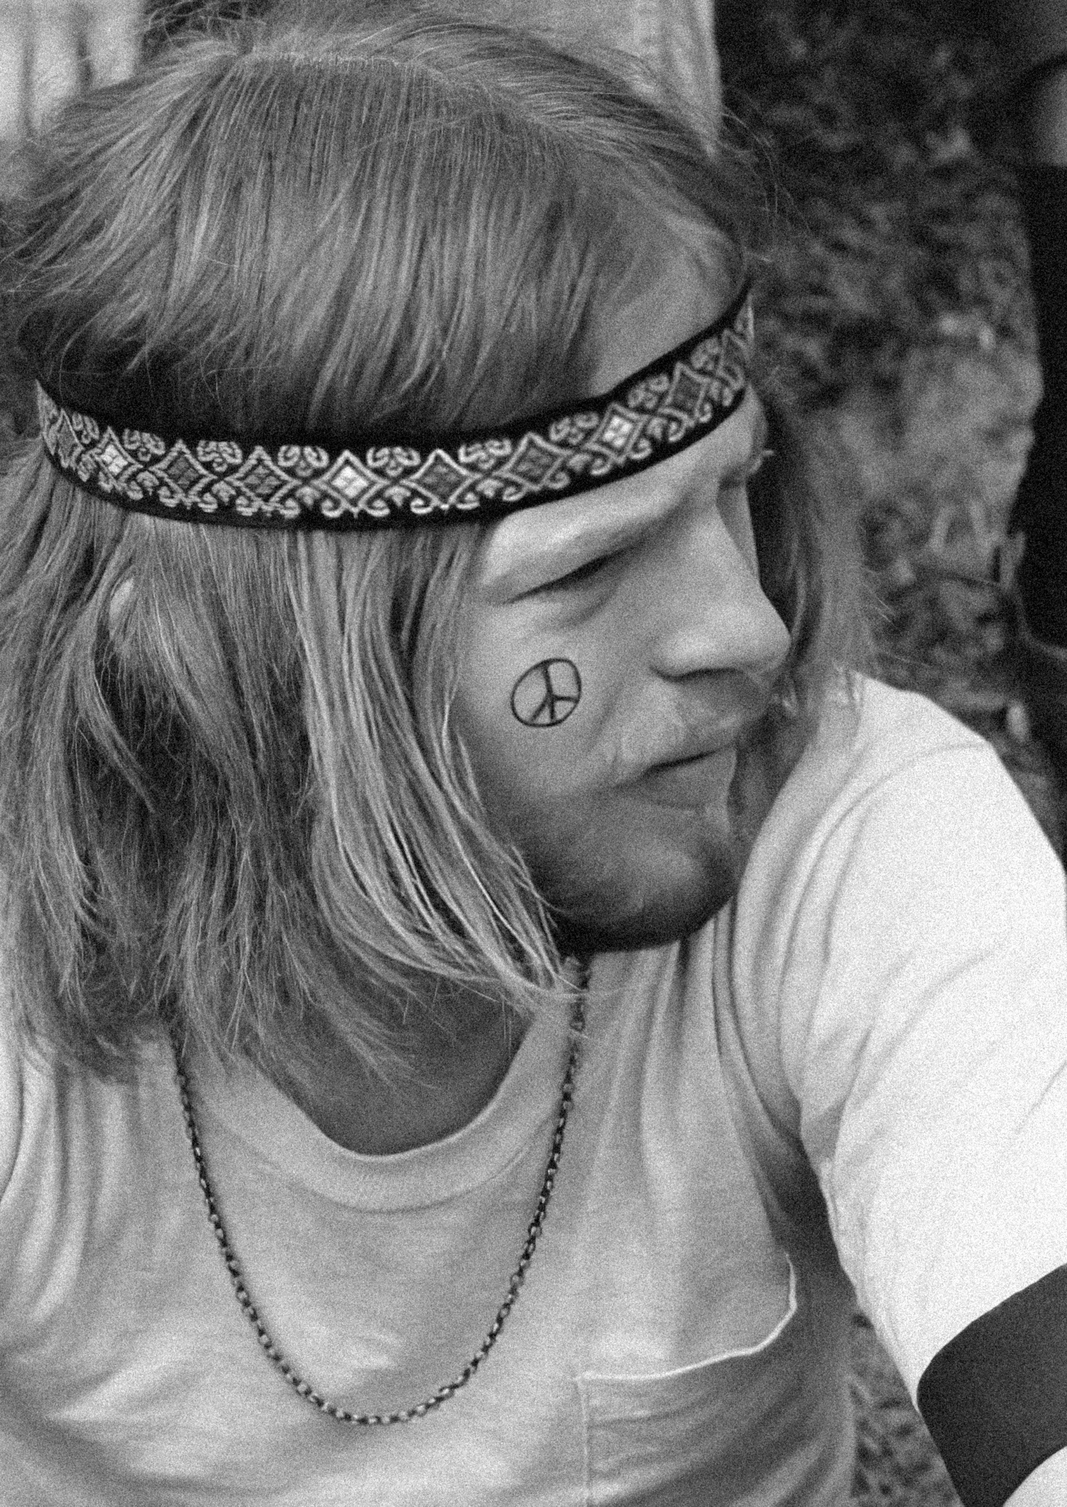
Hippies
https://unsplash.com/photos/a-man-with-a-peace-sign-tattoo-on-his-forehead-9TELXDxfzKo

Slide 12
Drug Use – Marijuana, LSD…
Fashion – beads, long hair and beards, colourful clothes
Music – Rock and Folk

Slide 13
Hippie Culture
rejected materialism and mainstream values
Eastern religions, astrology
freedom, spiritual enlightenment, civil rights
Summer of 1967 (Summer of Love)
an alternative to social concerns like racism, sexism and Vietnam war

Slide 14
Use of drugs
The experimental use of drugs
Timothy Leary
  Harvard researcher
  “invented” LSD (acid)
  advocated to “tune in, turn on, drop out”
  the idea was-open your mind, experimentation

Slide 15
Woodstock
1969, upstate NY
450,000 + attend
Jimmie Hendrix’s Star Spangled Banner and Country Joe & the Fish’s “I Feel like I’m fixin’ to Die Rag”

Slide 16
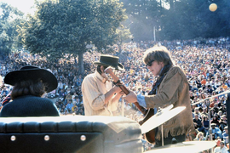
1967-“Summer of Love”
https://commons.wikimedia.org/wiki/File:KFRC_Fantasy_Fair_Dryden_Balin_Kantner.png

Slide 17
Legacy of the Counterculture
Attitudes
lifestyles and social behavior, art and music
changes in attitudes about sexual behavior
topics that were once taboo were explored.
helped inspire movements for civil rights, women’s rights and environmental activism

Slide 18
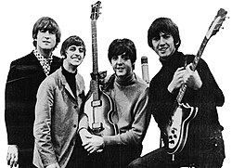
The Beatles
https://commons.wikimedia.org/wiki/File:Beatles_ad_1965_just_the_beatles_crop.jpg

Slide 19
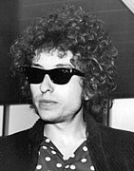
Bob Dylan
https://commons.wikimedia.org/wiki/File:Bob-Dylan-arrived-at-Arlanda-surrounded-by-twenty-bodyguards-and-assistants-391770740297_(cropped).jpg

Slide 20
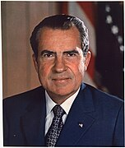
Richard Nixon
https://commons.wikimedia.org/wiki/File:Richard_M._Nixon,_ca._1935_-_1982_-_NARA_-_530679.jpg

Slide 21
«[W]e have been deluged by government programs for the unemployed, programs for the cities, programs for the poor, and we have reaped from these programs an ugly harvest of frustrations, violence and failure across the land .. . I say it's time to quit pouring billions of dollars into programs that have failed in the United States of America.»
Richard Nixon, Acceptance Speech, August 8, 1968

Slide 22
Nixon
New Federalism
«Southern strategy»
Drugs and crime

Slide 23
Nixon
Environmentalism
  1970 – The Clean Air Act
  Environmental Protection Agency

Slide 24
Henry Kissinger and realpolitik
Realpolitik -> basing foreign policies on realistic views of given circumstances rather than on broad rules or idealism
Détente

Slide 25
Nixon and China
Communist People's Republic of China
1971 - the People's Republic made an invitation to an American table tennis team to play in a tournament
«ping-pong diplomacy»

Slide 26
Middle East
Israel occupied territories of Egypt, Syria and Jordan.
Oil embargo - Organization of Petroleum Exporting Countries (OPEC)
Kissinger and shuttle diplomacy

Slide 27
Watergate Scandal
John Ehrlichman and H. R. Haldeman created «Plumbers».
Daniel Ellsberg's psychiatrist
offices of the Democratic National Committee at the Watergate hotel-office complex
The Washington Post - Bob Woodward and Carl Bernstein

