Slide 1
English Poetry-I

Slide 2
Week 1
What is poetry?
Types of poetry (epic, dramatic, lyric, pastoral, elegy, sonnet, etc.)
Elements of poetry (stanza, meter, rhyme, tone, diction, imagery, etc.)
Poetic devices (alliteration, assonance, onomatopoeia, etc.)
Figures of speech (simile, metaphor, personification, apostrophe, hyperbole, metonymy, synecdoche, paradox, symbol, etc.)

Slide 3
Week 2
Old English poetry
Heroic poems (Beowulf, The Battle of Brunanburh, etc.)
Religious poems ("Caedmon's Hymn", The Dream of the Rood, etc.)
Elegies (The Wanderer, The Seafarer, etc.)

Slide 4
Week 3
Middle English poetry
Verse chronicles (Brut, etc.)
Lyric poems ("Sumer is icumen in", etc.)
Metrical romances (Sir Gawain and the Green Knight, etc.)
Dream visions (The House of Fame, The Parlement of Foules, etc.)
The Gawain poet, William Langland (Piers Plowman), John Gower
Geoffrey Chaucer (The Canterbury Tales)

Slide 5
Week 4
16th-century poetry
The effect of the Renaissance
The introduction of the sonnet

Slide 6
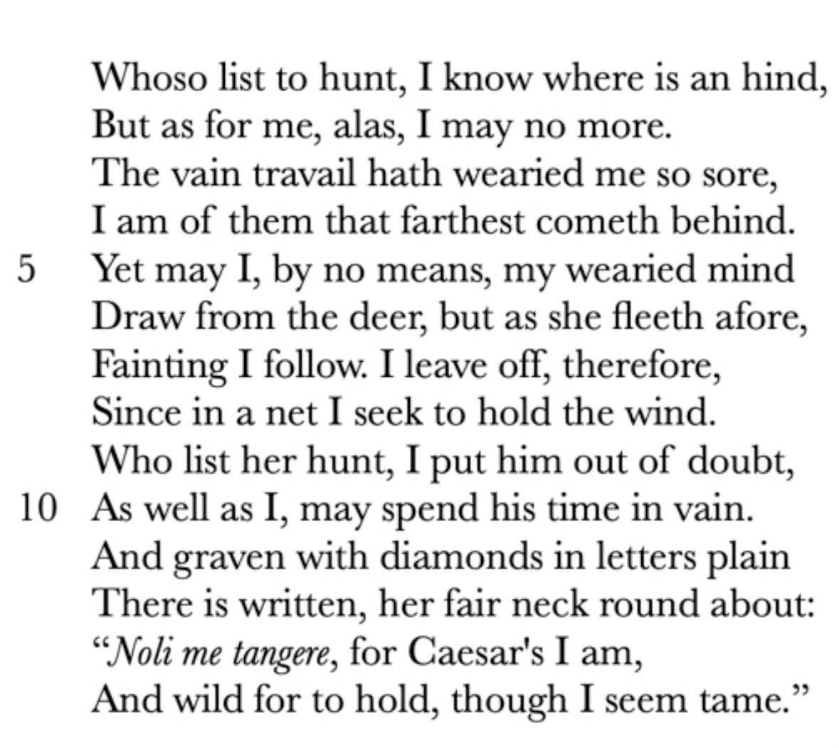
Week 5
Sir Thomas Wyatt and Earl of Surrey

Slide 7
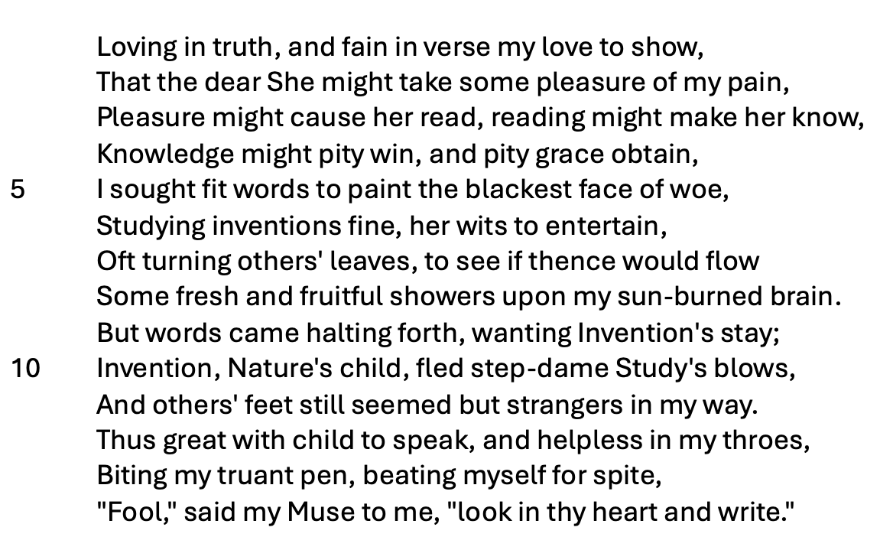
Week 6
Sir Philip Sidney and Edmund Spenser

Slide 8
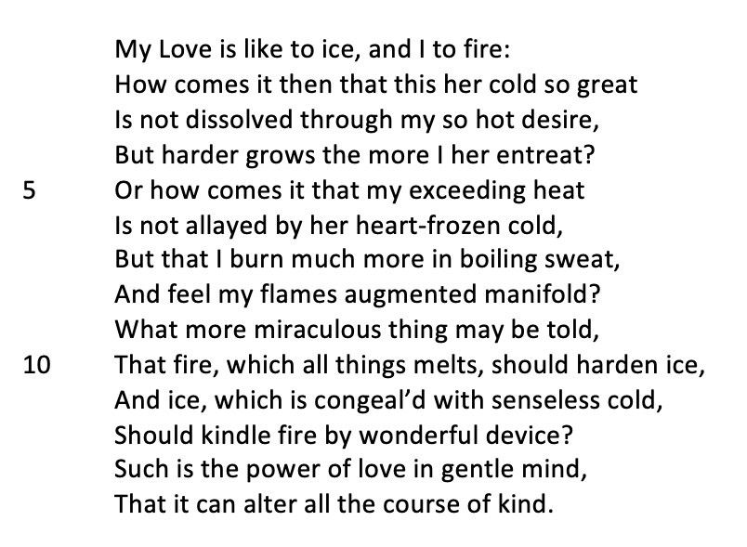
Week 6

Slide 9
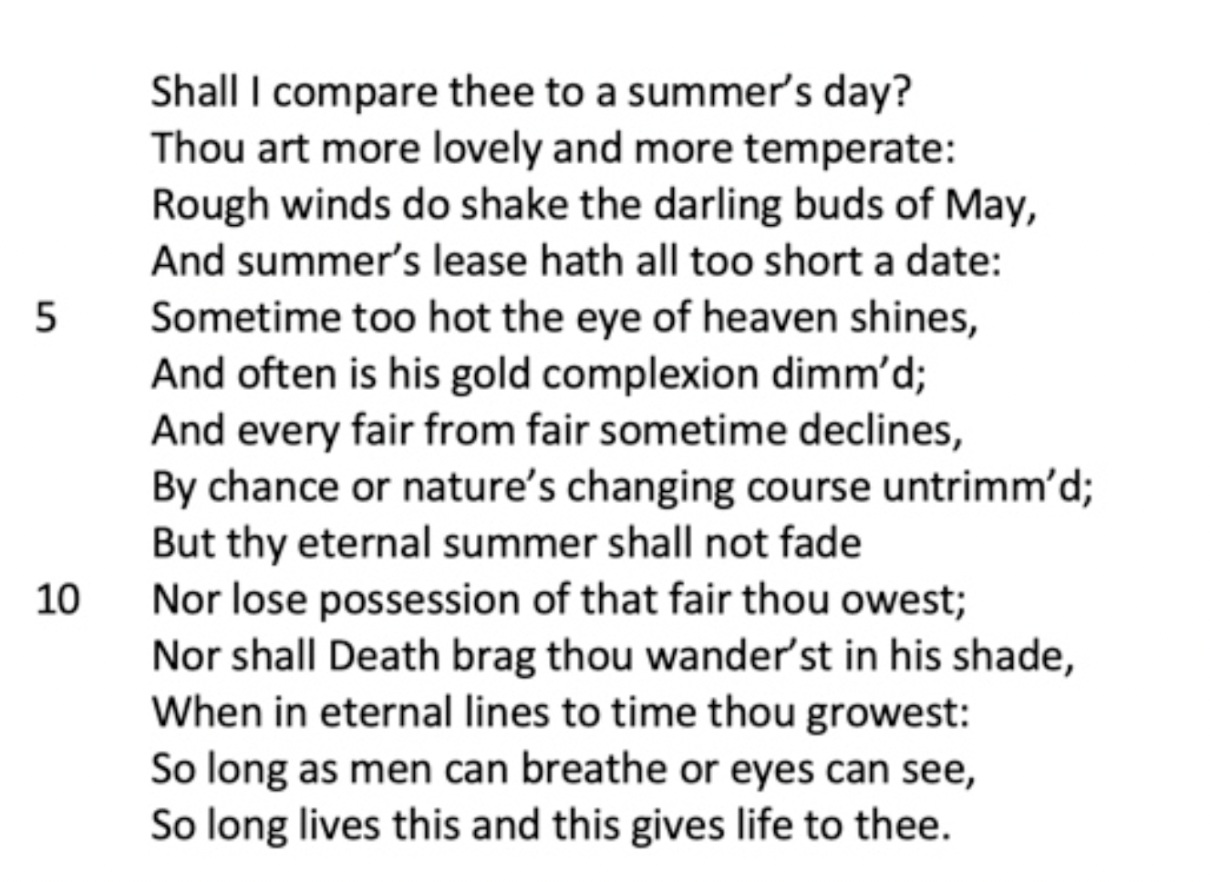
Week 7
The evolution of the sonnet and love poetry
Shakespeare

Slide 10
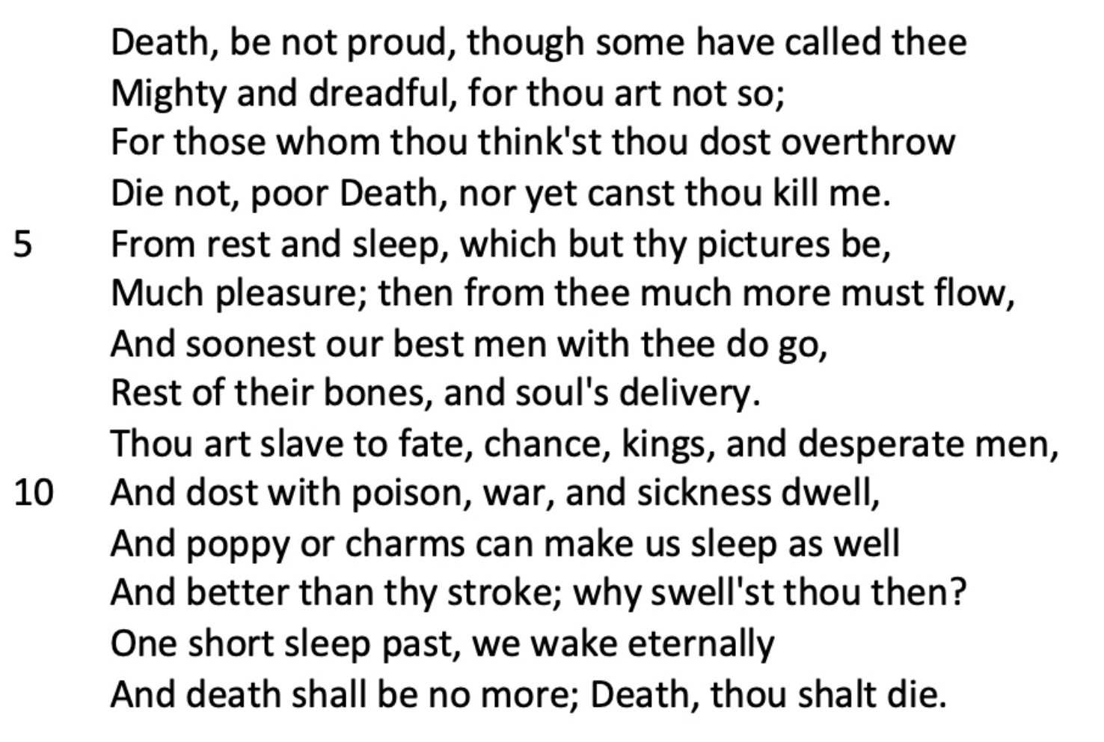
Week 8
17th-century poetry
Metaphysical poetry, John Donne, George Herbert

Slide 11
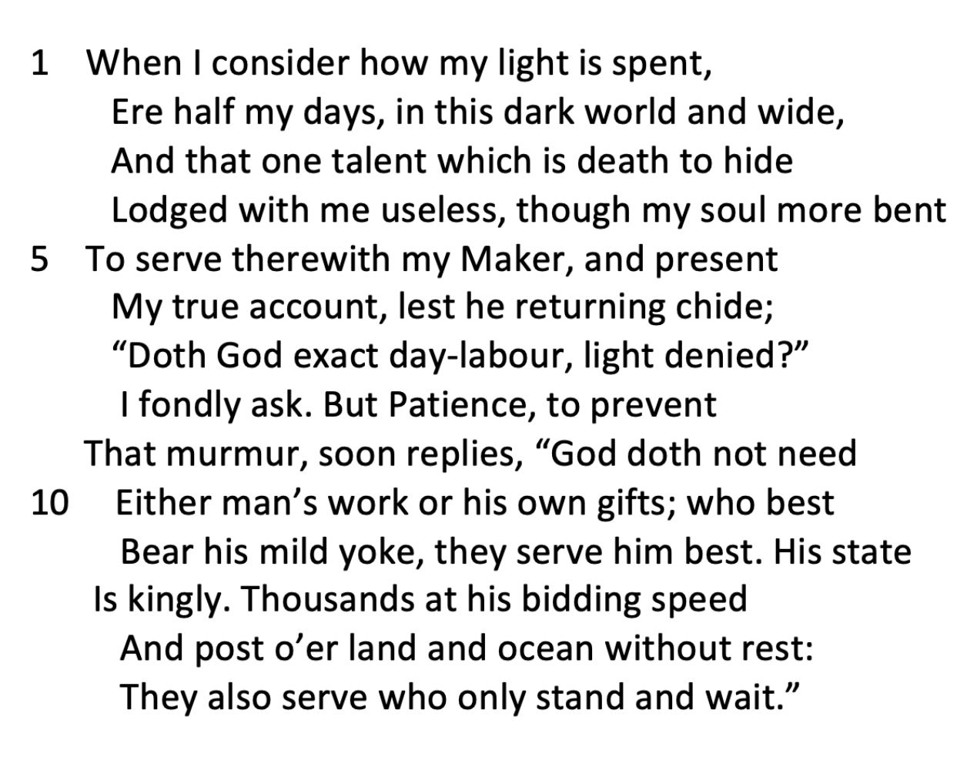
Week 9
Cavalier poets, Ben Jonson
John Milton (Paradise Lost)

Slide 12
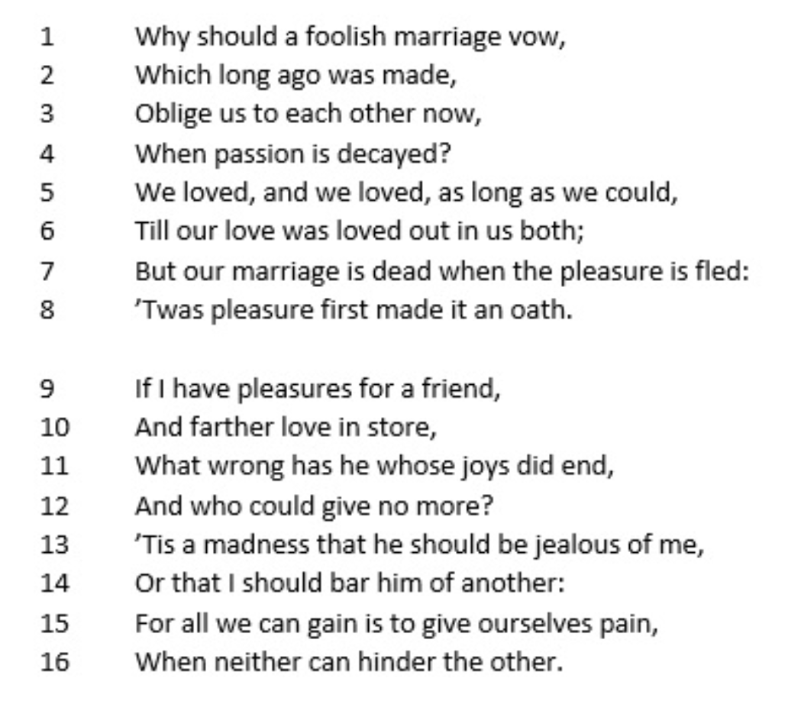
Week 10
Neoclassical poetry, mock-epic satires
John Dryden

Slide 13
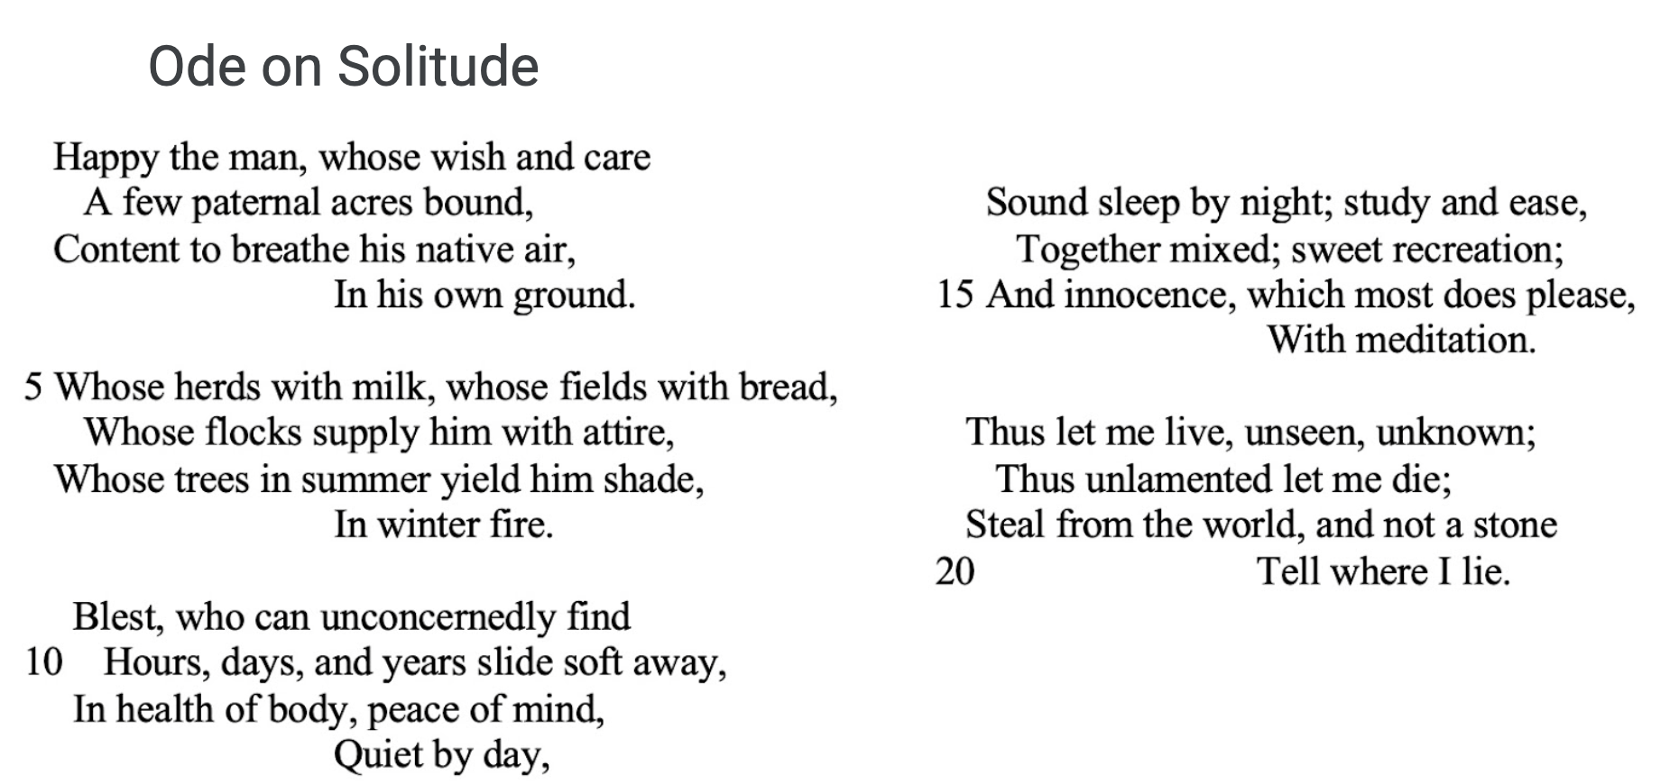
Week 11
18th-century poetry, Alexander Pope
Women poets

Slide 14
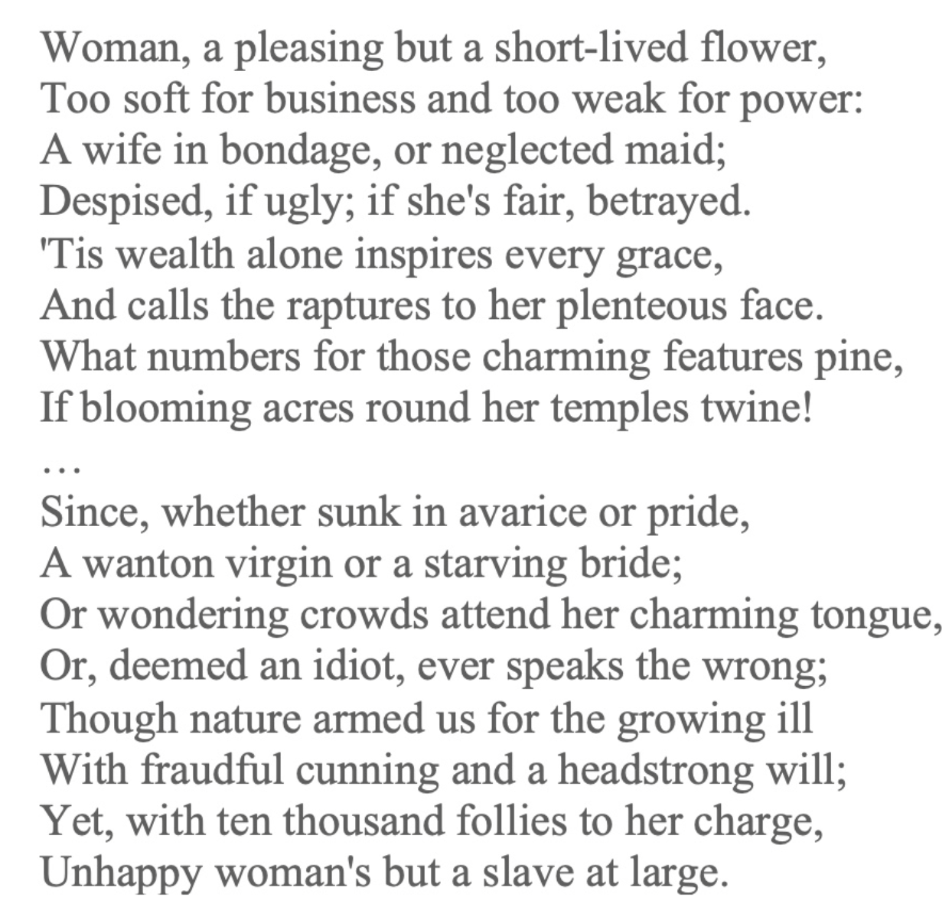
Week 11

Slide 15
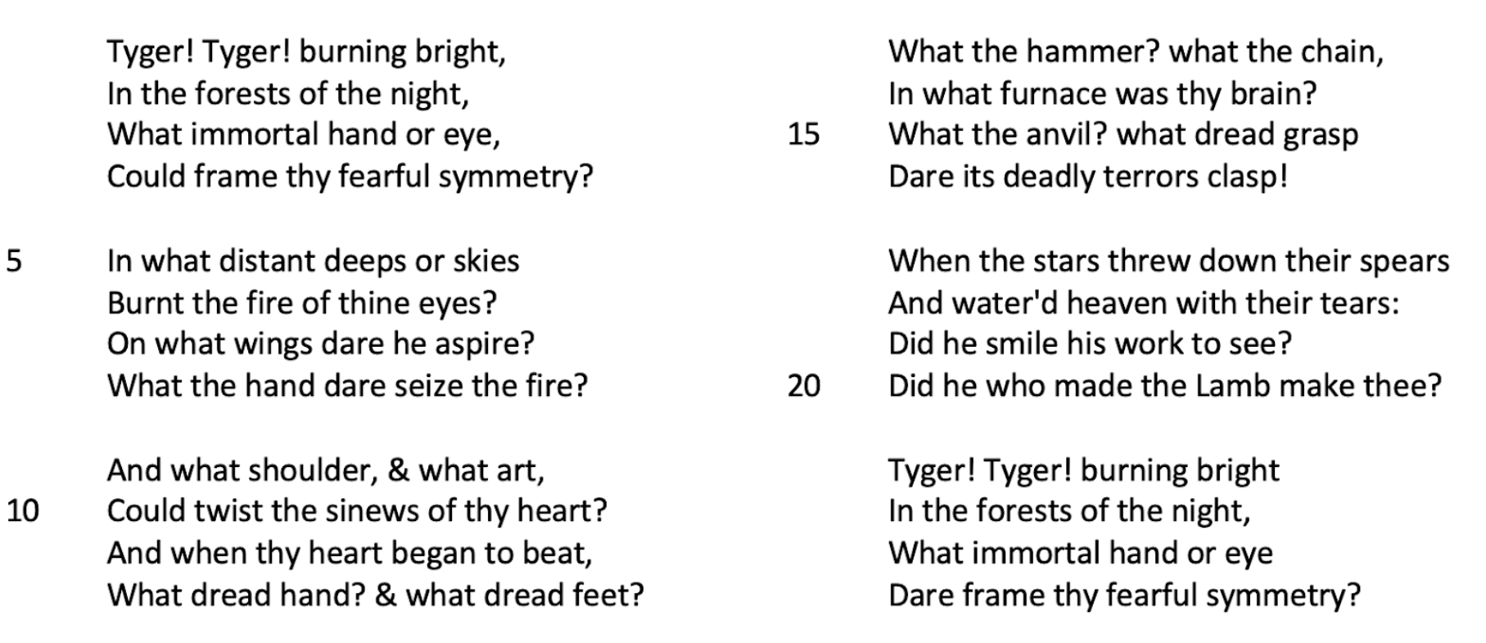
Week 12
Romantic movement
Early figures of romantic poetry, Robert Burns, William Blake

Slide 16
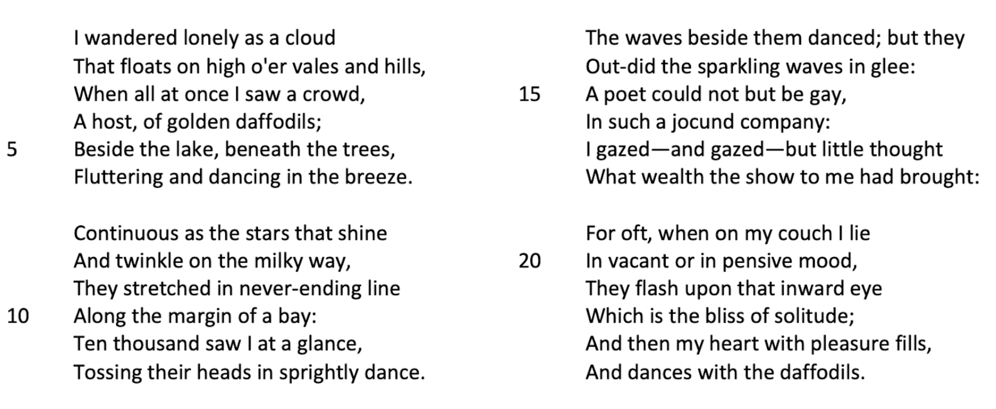
Week 13
First generation of romantic poets, William Wordworth and Samuel Taylor Coleridge
Second generation of romantic poets, Lord Byron

Slide 17
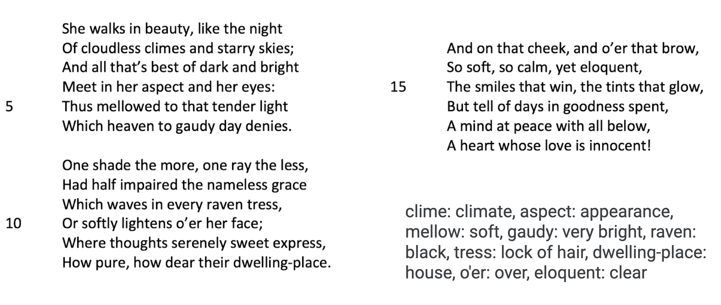

Week 13

Slide 18
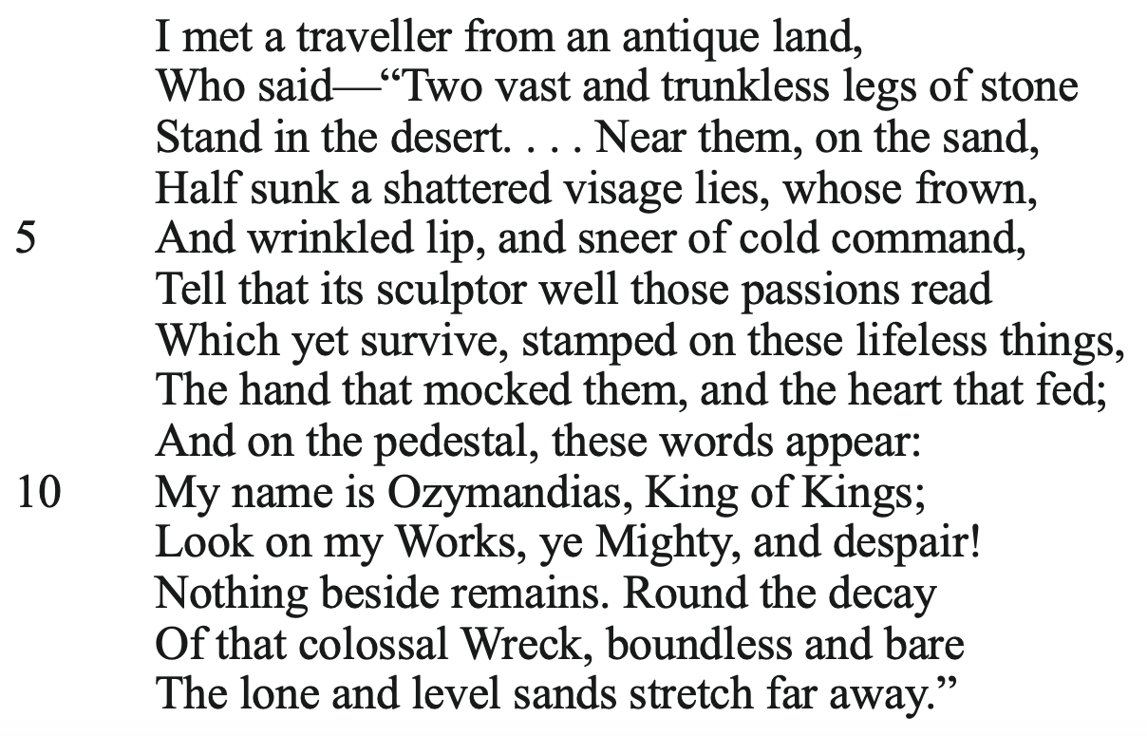
Week 14
Second generation of romantic poets
Percy Shelley, John Keats

Slide 19
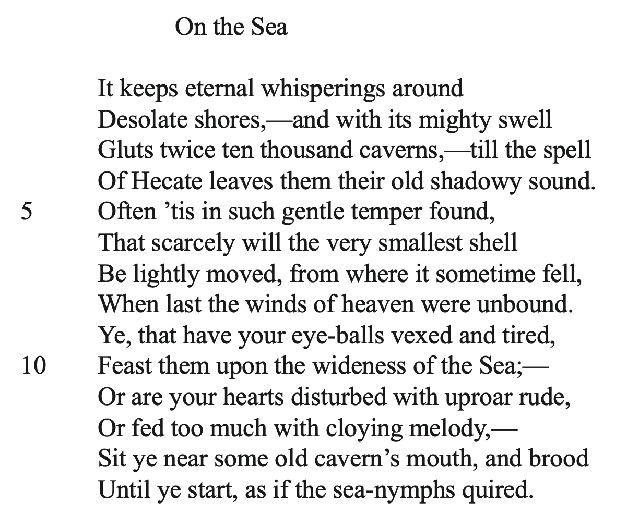
Week 14

